Slide 1
Differential Expression
using RNA-Seq
Victoria Offord
WTC NGS Bioinformatics
Hinxton 2019

Slide 2
Overview
RNA-seq background
Mapping to the genome (HISAT2 and IGV)
Mapping to the transcriptome and counting reads (Kallisto)
Read count normalisation
Differential expression and QC (Sleuth)
What to do with a gene list
The exercise

Slide 3
What is the transcriptome?
“The complete set of transcripts in a cell
and their quantity
for a specific developmental stage or condition”
Wang et al. (2009)
Nature Reviews Genetics
(PubMed: 19015660)
Notes:
snapshot
fixed point in time
fixed set of conditions

Slide 4
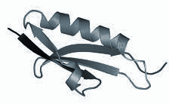
Central dogma
DNA
5’ UTR
Intron
Exon 1
Intron
Exon 2
Intron
Exon 3
3’ UTR
transcription
Pre-mRNA
5’ UTR
Intron
Exon 1
Intron
Exon 2
Intron
Exon 3
3’ UTR
splicing
capping
tailing
mRNA
5’ UTR
Exon 1
Exon 2
Exon 3
3’ UTR
translation
Protein
Notes:
Central dogma of biology
DNA transcribed into pre-mRNA
Pre-mRNA processed into mature mRNA (5’ cap and poly-A tail)
mRNA is translated into protein

Slide 5
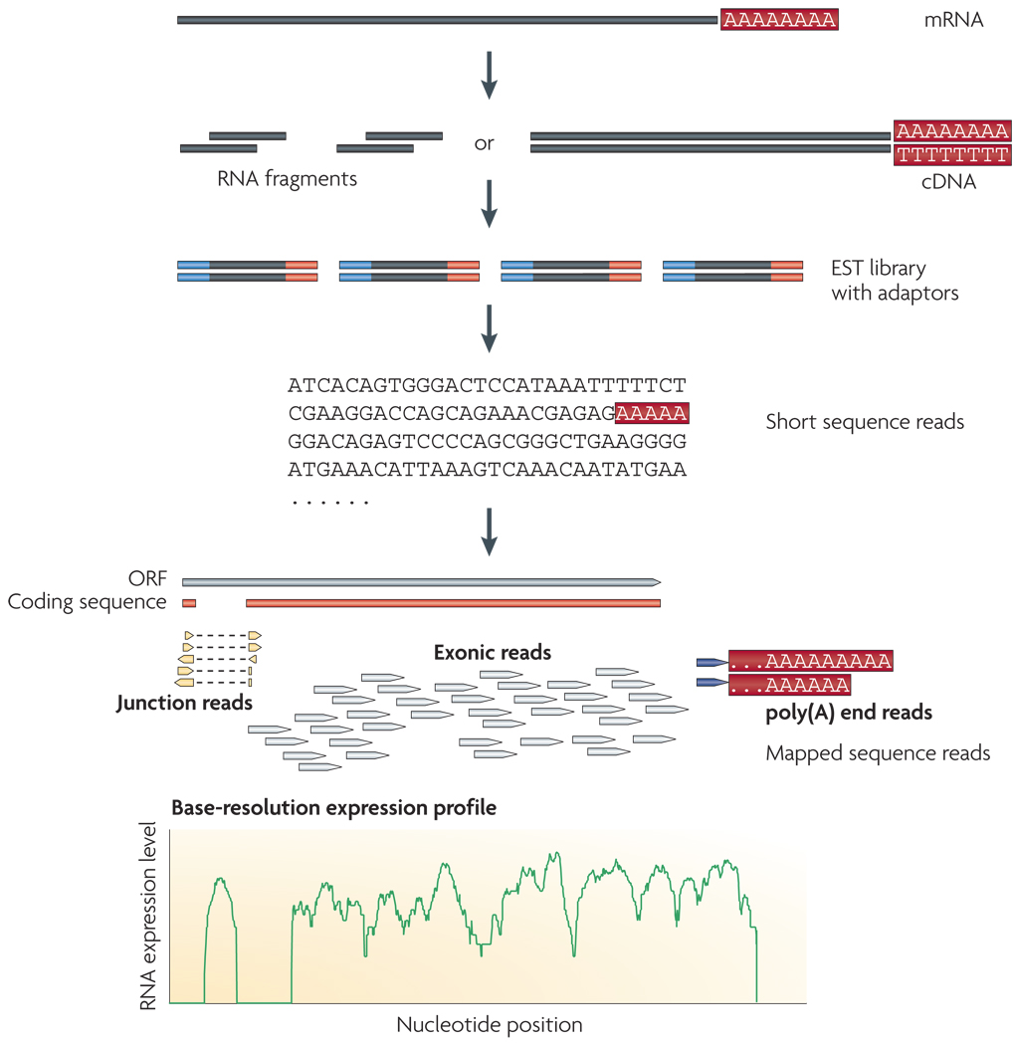
RNA Sequencing
Wang et al. (2009)
Nature Reviews Genetics
(PubMed: 19015660)
Notes:
Library of cDNA fragments
Add sequencing adaptors
Sequencing
Align reads to genome or transcriptome
Base-resolution expression profile for each gene

Slide 6
Experimental design
Successful RNA-Seq studies start with a good study design
Considerations for generating data to answer your biological question include:
library type
sequencing depth
number of replicates
avoiding biases

Slide 7
Experimental design - library preparation
Total RNA = mRNA + rRNA + tRNA + regulatory RNAs...
Ribosomal RNA can represent > 90% total RNA
Can enrich for the 1-2% mRNA or deplete rRNA
enrichment typically needs good RIN and high RNA proportion
some samples (e.g. tissue biopsies) may not be suitable
bacterial mRNA not polyadenylated -> ribosomal depletion
Be aware of protocol being used (e.g. some will remove small RNAs)
Notes:
Total RNA = mRNA, rRNA, transfer RNAs (tRNA), regulatory RNAs (siRNA, miRNA, piRNA)
rRNA >90% of total RNA
polyA selection (not in bacteria)
BEWARE OF PROTOCOLS: some will remove small RNA which you might want
PCR amplification can reduce coverage of transcripts or regions with a high GC content (can use amplification-free protocol)
Vague estimate 10-30M (SE, 50-75bp) for DGE and 50-100M (PE, 2x75bp) for alternative splicing

Slide 8
Experimental design - library type
Stranded vs unstranded
strand-specific protocols better for detangling antisense or overlapping transcripts
Single or paired end
paired end better for de novo transcript discovery or isoform expression analysis
< 55% reads will span 2 or more exons
Notes:
BDNF in human genome = overlapping exons
BDNF protein encoding gene on -ve (mRNA)
BDNF-AS regulatory RNA on +ve (ncRNA)
10-30M (SE, 50-75bp) for DGE
50-100M (PE, 2x75bp) for alternative splicing

Slide 9
Experimental design - replicates
Biological replicates
biologically distinct samples
same type of organism treated or grown in the same condition
understand biological variation (e.g. variation between individuals)
relevant biological replicates are required
Technical replicates
repeated measurements of the same sample
understand the variation in equipment or protocols
technical replicates are not generally required, but try to arrange samples on plates to minimise potential problems
Notes:
biological replicates > accuracy of logFC and absolute expression levels (particularly in low expression transcripts)
reduces the coefficient of variation

Slide 10
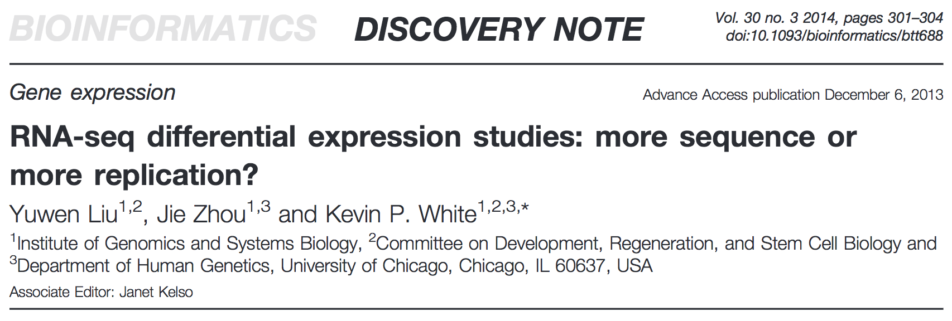
Experimental design - sequencing depth / replicates
Increasing sequencing depth can increase the ability to detect low expression transcripts (i.e. increases ability to detect DE genes)
Returns diminish beyond a certain sequencing depth
Increasing biological replicates increases the accuracy of logFC and absolute expression levels (particularly in low expression transcripts)
reduces the coefficient of variation
Notes:
Sequencing depth
returns diminish beyond a certain sequencing depth = increases noise
10-30M (SE, 50-75bp) for DGE
50-100M (PE, 2x75bp) for alternative splicing
Blocking
Reduce confounding factors
E.g. a study looking at WT and KO mice with 4x males in WT and 4x females in KO (gender is a confounding factor as cannot distinguish its effect from treatment)
Better study design would be 2 males and 2 females in WT and KO. You can then account for gender in the model downstream.
Randomising
If you have a group of patients: half will get placebo and half will get a drug
Patients should be randomly assigned to each group (blind assignment)

Slide 11
What do we need to know?
Which genes/transcripts do our reads belong to? mapping / assembly
How many reads align to a specific gene/transcript? quantification
Do different sample groups express genes/transcripts differently? DGE analysis

Slide 12

No universal pipeline to cover every analysis!!!
Notes:
No one pipeline for every analysis
Depends on the organism you’re studying
Depends on the biological question being asked
Reference available
infer the transcripts and then quantify
won’t find novel isoforms
Reference NOT available
De novo assemble transcripts
Use assembled transcripts to quantify

Slide 13
Sequence reads
Genome alignment
HISAT2, STAR, GSNAP...
Pseudoalignment to transcriptome
(counting comes for free)
Kallisto, Sailfish, Salmon...
Transcript identification
and counting
featureCounts, htseq_count...
Differential expression
EdgeR, DESeq2, limma-voom
Differential expression
Sleuth
Notes:
Reference-based mRNA analysis broad sweeps
Sequence your sample
Map back to your genome
gives an idea of context and is easier to visualise
Estimate gene/transcript abundance
Count reads assigned to each transcript
Pseudoalignment = that read is assigned but not where = counting comes for free
DGE analysis
How does gene expression change between conditions
Functional analyses

Slide 14
Mapping RNA-seq reads to the genome (HISAT2)
Mapping to the genome is great for determining whether your RNA-seq data is of high quality and exploring the structure of genes of interest
Eukaryotic genes have introns, which are not present in mature mRNA so special mapping algorithms are required (splice-aware)
HISAT2 is only one such algorithm, but is accurate, fast and easy to use
Notes:
Genome alignments are easier to visualise
Other methods include the ‘tuxedo’ protocol: HISAT2 (alignment) -> StringTie (transcript assembly/coverage) -> Ballgown (DE)
HISAT2 indexes the genome efficiently - uses less space so rapidly searchable

Slide 15
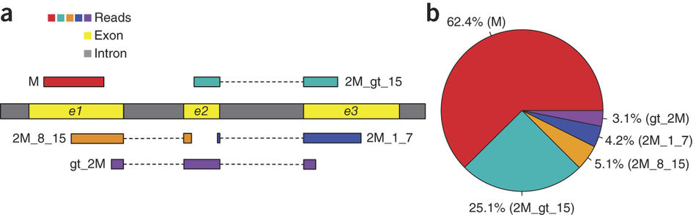
Splice aware alignment
Anchor
Kim et al. (2015)
Nature Methods
(PubMed: 25751142)
Notes:
Some reads will fall entirely within a single exon
Others span exon-exon boundaries
Mapping against a genome (which has introns) requires a mapping tool able to handle gapped alignments = splice-aware aligners.
Shorter aligned region is known as the anchor
Anchors which are >10bp are often difficult to place = multiple alignments.
May have option to provide a reference annotation with known of exon-exon boundaries and splice sites
M single exon
2M gt 15 = 2 exons = long anchor (>16bp) = mostly unique mapping
2M gt 15 = 2 exons = intermediate anchor (8-15bp)
8bp sequence can occur ~48,000 times in human genome
HISAT2 maps to a global index and then uses a local index to refine
Local index is 64,000bp so covers >90% introns - on average 8bp sequence will occur once in local index
2M_1_7 = 2 exons = short anchor
Tricky to align
HISAT uses information from other reads
gt_2M = > 2 exons

Slide 16
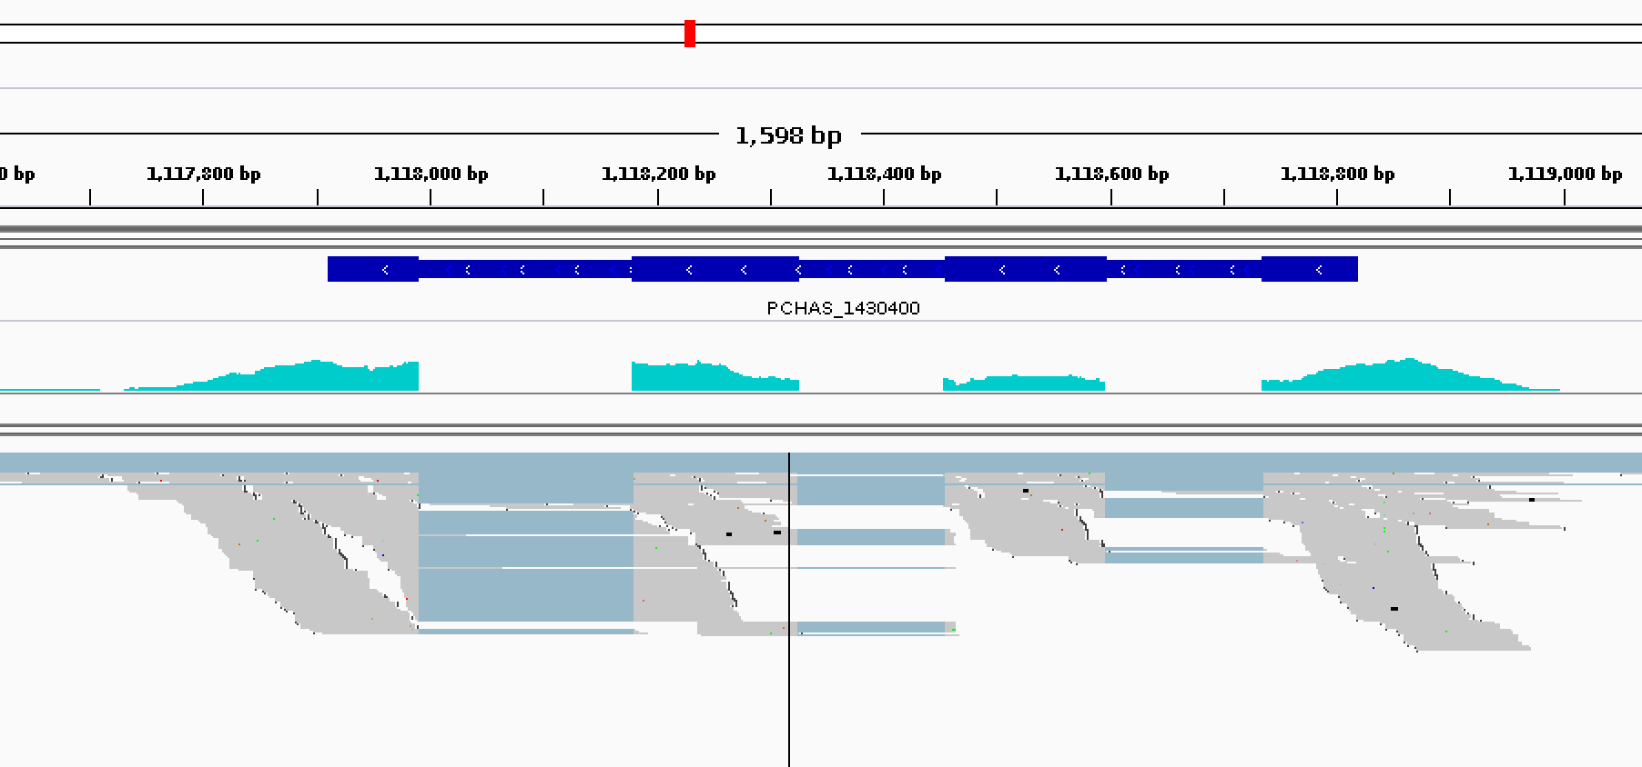
Visualisation: Integrative Genomics Viewer (IGV)

Slide 17
Mapping to the transcriptome and counting reads
(Kallisto)
Multiple splice forms per gene introduce ambiguity into the mapping
Mapping to the spliced transcript sequences allows this ambiguity to be taken into account and allows transcript-specific read counts
It is also faster because there is less target sequence
Recent improvements in algorithms (pseudoalignment) make this even faster
doesn’t care where in each transcript reads map to, just which of the transcripts they map to
Counting comes for free

Slide 18
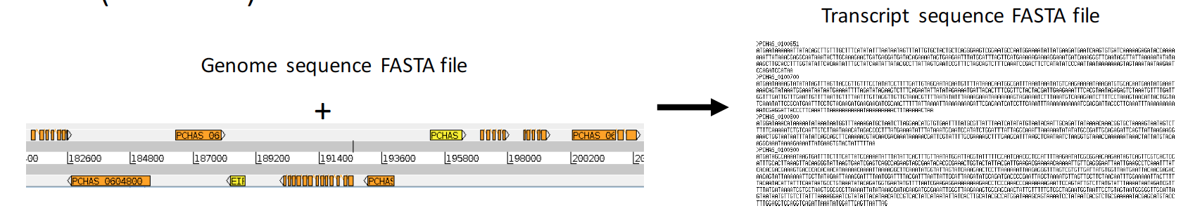
Mapping to the transcriptome and counting reads
(Kallisto)
Kallisto has two steps:
Building an index from the spliced transcript sequences
Quantify reads against the index
Kallisto cannot be used to identify novel transcripts
Notes:
Kallisto has two steps
Build index of transcripts (kmers)
Quantify reads against index
Kallisto does not perform transcript assembly
User provides transcript sequences
Can’t identify novel transcripts
Builds index of the human transcriptome in <10 minutes on a laptop

Slide 19
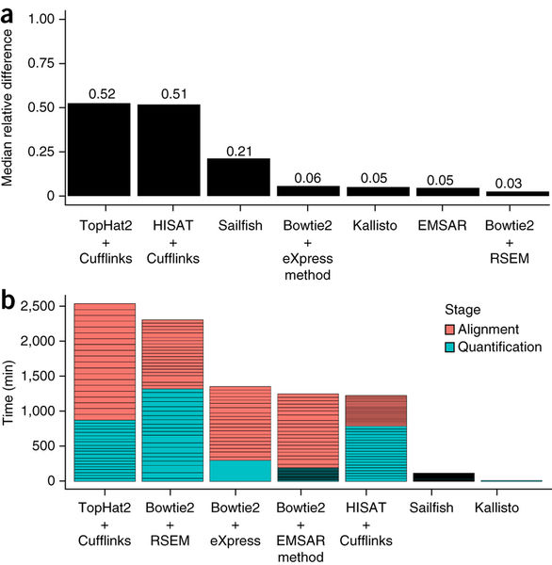
Mapping to the transcriptome and counting reads
(Kallisto)
Bray et al. (2016)
Nature Biotechnology
(PubMed: 27043002)
Notes:
Kallisto is both fast (right) and accurate (left)
How does it achieve this speed?
Pseudoalignment
Evaluates kmers (short sections of the reads)
Doesn’t care where the read aligns
Constructs a target de Bruijn graph from the transcriptome
essentially a path through the transcriptome
Skips over kmers where compatibility doesn’t change
~60% of reads you only need to know where first and last kmer matches
hashing of all kmers are needed for only ~1.6% reads
Only looks for exact matches (discards those containing sequencing errors - i.e. cannot be mapped)
Being quicker also means that it has time to do bootstrapping -
Data is sampled and subsampled many times
Gets an estimate of technical variance
Can be subtracted downstream to understand what the biological variance is
Both graphs are based on 20 RSEM simulations of 30 million 75-bp paired-end reads based on the abundances and error profile of GEUVADIS sample NA12716_7

Slide 20
Normalisation
Runs with more depth will have more reads mapping to each gene (sequencing depth bias)
Longer genes will have more reads mapping to them (gene length bias)
Most methods will normalise for sequencing depth and gene length
Notes:
Goal is to provide scaling of the estimates to make them comparable across samples - never use raw numbers

Slide 21
Normalisation methods
RPKM - reads per kilobase per million
FPKM - fragments per kilobase per million
TPM - transcripts per million
Some of these methods have problems with highly expressed genes, so it’s better to use more complicated normalisation procedures (DESeq2 rlog, Sleuth)
Notes:
Goal is to provide scaling of the estimates to make them comparable across samples - never use raw numbers
RPKM = SEQ DEPTH then GENE LEN
FPKM = fragments = two reads can map to one fragment = doesnt count fragment twice
TPM = GENE LEN then SEQ DEPTH
Proportion of how much you sequenced this transcript relative to everything else you sequenced in the sample
RPKM
Reads per killobase million
Count up the total reads in a sample and divide that number by 1 million – this is our “per million” scaling factor.
Divide the read counts by the “per million” scaling factor. This normalizes for sequencing depth, giving you reads per million (RPM)
Divide the RPM values by the length of the gene, in kilobases. Normalises for gene length, this gives you RPKM.
FPKM
Fragments per kilobase million
RPKM was made for single-end RNA-seq, where every read corresponded to a single fragment that was sequenced so FPKM was made for paired-end RNA-seq.
FPKM takes into account that two reads can map to one fragment (and so it doesn’t count this fragment twice)
TPM
Transcripts per million
Proportion of how much you sequenced this transcript relative to everything else you sequenced in the sample
When calculating TPM, the only difference is that you normalize for gene length first, and then normalize for sequencing depth second. However, the effects of this difference are quite profound.
When you use TPM, the sum of all TPMs in each sample are the same. This makes it easier to compare the proportion of reads that mapped to a gene in each sample.
In contrast, with RPKM and FPKM, the sum of the normalized reads in each sample may be different, and this makes it harder to compare samples directly.
TPM extra
Divide the read counts by the length of each gene in kilobases. This gives you reads per kilobase (RPK).
Count up all the RPK values in a sample and divide this number by 1,000,000. This is your “per million” scaling factor.
Divide the RPK values by the “per million” scaling factor. This gives you TPM.

Slide 22
RPKM
Adapted from StatQuest (http://statquest.org)
BEFORE
Gene | Replicate 1 Counts | Replicate 2 Counts | Replicate 3 Counts
A (2,000 bases) | 10 | 12 | 30
B (4,000 bases) | 20 | 25 | 60
C (1,000 bases) | 5 | 8 | 15
D (10,000 bases) | 0 | 0 | 1
AFTER
Gene (bases) | Replicate 1 RPKM | Replicate 2 RPKM | Replicate 3 RPKM
A (2,000 bases) | 1.43 | 1.33 | 1.42
B (4,000 bases) | 1.43 | 1.39 | 1.42
C (1,000 bases) | 1.43 | 1.78 | 1.42
D (10,000 bases) | 0 | 0 | 0.009
Notes:
RPKM
Reads per killobase million
Normalise for sequencing depth first then gene length
B not bigger than A - gene is just double the length

Slide 23
FPKM (fragments per kilobase million)
RPKM for paired reads
takes into account that two reads can map to one fragment (and so it doesn’t count this fragment twice)
Single end
Paired end
Notes:
FPKM
Fragments per kilobase million
RPKM was made for SE RNA-seq, where
every read corresponded to a single fragment that was sequenced
FPKM was made for paired-end RNA-seq.
two reads can map to one fragment (and so it doesn’t count this fragment twice)

Slide 24
RPKM vs TPM
RPKM
TPM
Gene | R1 | R2 | R3
A | 1.43 | 1.33 | 1.42
B | 1.43 | 1.39 | 1.42
C | 1.43 | 1.78 | 1.42
D | 0 | 0 | 0.009
Total | 4.29 | 4.5 | 4.25
Gene | R1 | R2 | R3
A | 3.33 | 2.96 | 3.326
B | 3.33 | 3.09 | 3.326
C | 3.33 | 3.95 | 3.326
D | 0 | 0 | 0.02
Total | 10 | 10 | 10
Easier to see the proportion of each gene within a sample as sum of TPMs same across samples
Adapted from StatQuest (http://statquest.org)
Notes:
TPM
Transcripts per million
Proportion of how much you sequenced this transcript relative to everything else you sequenced in the sample
Normalise for gene length first then sequencing depth
Sum of all TPMs in each sample are the same
Easier to compare the proportion of reads that mapped to a gene in each sample.
With RPKM and FPKM, normalized reads in each sample may be different,
Harder to compare samples directly

Slide 25
Determining differential expression (Sleuth)
We don’t normally have enough replicates to do traditional tests of significance for RNA-seq data
Most methods look for outliers in the relationship between average abundance and fold change
Assume most genes are not differentially expressed
Notes:
Companion tool to kallisto
User friendly interface (Shiny)
Can utilize the technical variation information generated by Kallisto
Tests two models
Abundances equal between conditions (reduced model)
Abundances differ between conditions (full model)
Identifies transcripts with a significantly better fit with the “full” model
Multiple hypothesis testing - if we have 10,000 genes then using a p-value of 0.05 we would expect 500 genes to be significant just by chance (q value)

Slide 26
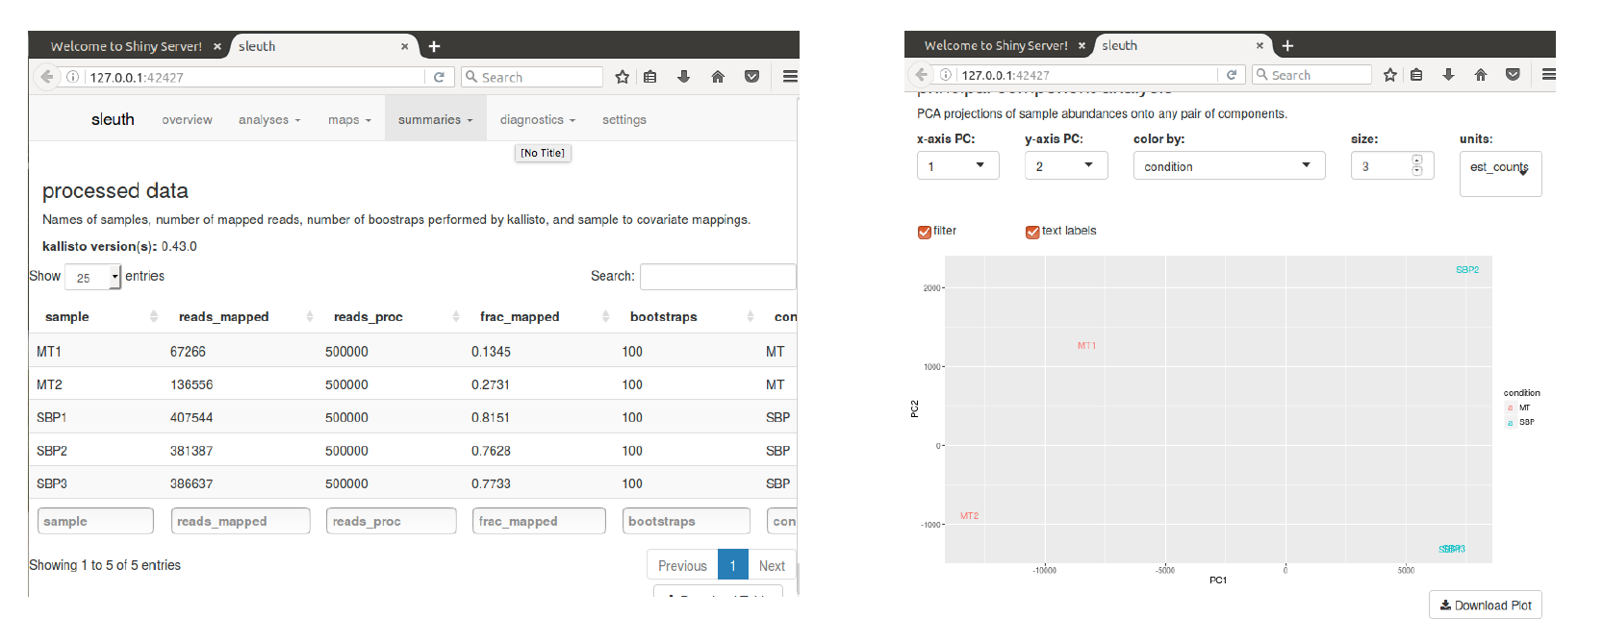
QC with Sleuth

Slide 27
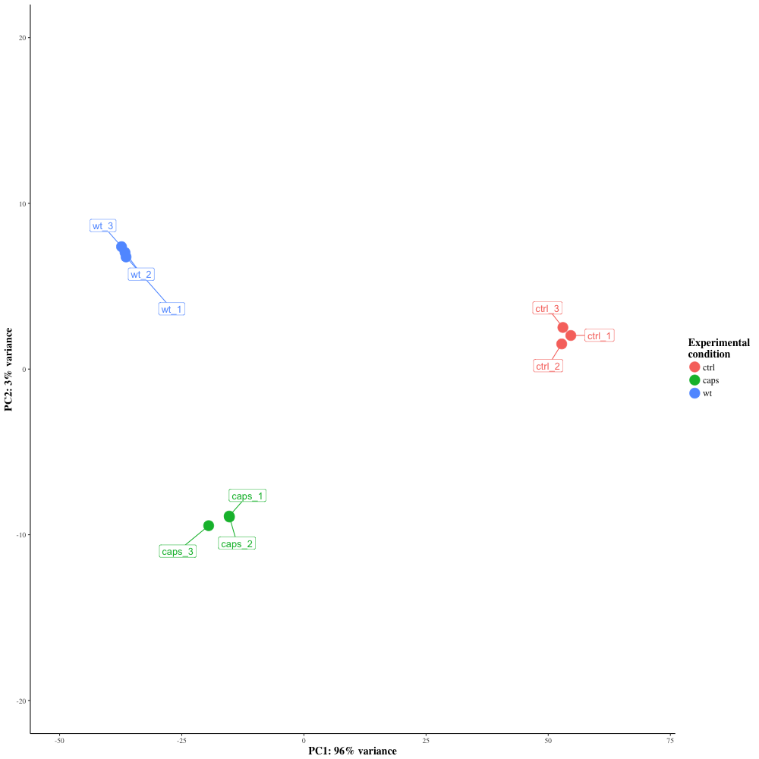
Principal component analysis (PCA)
Use to look at variation and strong patterns within data
Identifies uncorrelated variables or principal components (PC)
Tries to explain the maximum amount of variance with the smallest number of principal components

Slide 28
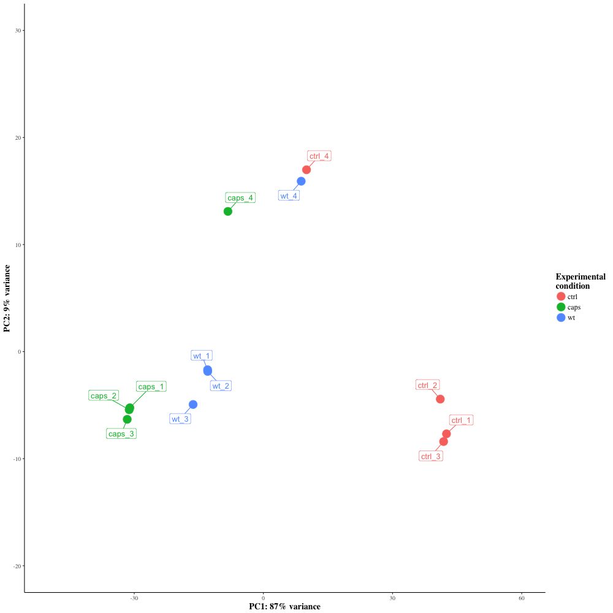
Why QC our data?
Notes:
Clean data looks great, but what about when there are issues (e.g. batch effects)
In this dataset we have three conditions:
Uninfected control
Infection with capsulated K.pneumoniae
Infection with uncapsulated K.pneumoniae
4th replicates were performed on a different day (possibly by a different person?)
Batch effects can be accounted for in the downstream analysis
In this case there were enough replicates to discard these samples
The cleaner the data, the more robust the analysis

Slide 29
What to do next with your gene list
When you have a list of differentially expressed genes, things start to get difficult.
What to do:
Have a hypothesis already? Test it.
GO term/pathway/gene-set enrichment analysis (GSEA, TopGO, InnateDB, Ingenuity Pathway Analysis etc.)
Work through list, Google, read papers
Overlay datasets on essentiality, populations, mutations, Pfam domains, chromosomal location, expression, proteome…
Then make a hypothesis about what genes are interesting and why. Can you
test/explore this further bioinformatically? Design the next wet lab experiment
Notes:
What we have covered so far is well established methodology,
which is generally applicable to most experiments

Slide 30
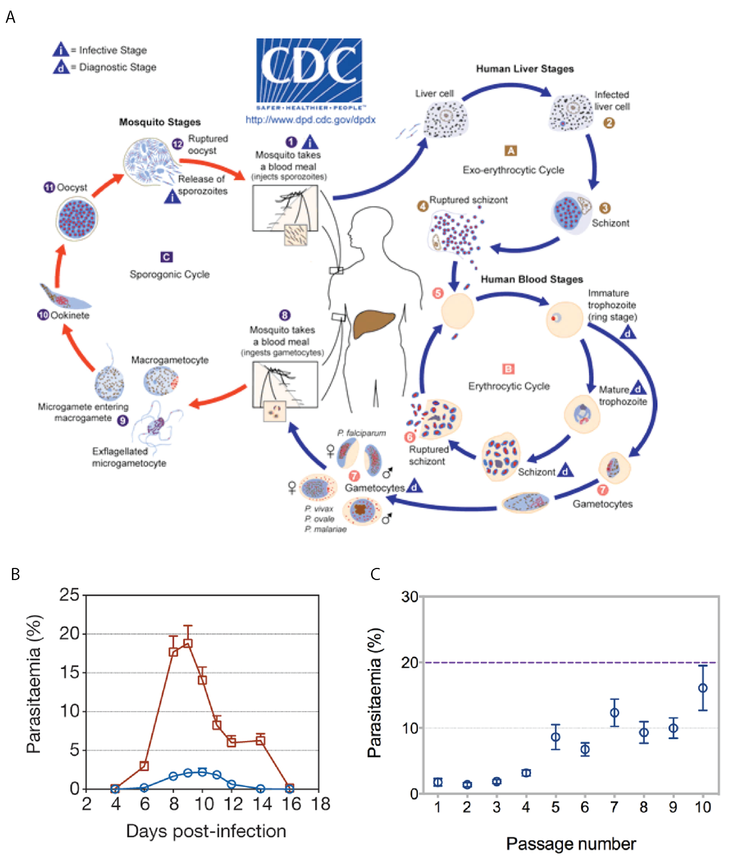
The exercise
Plasmodium chabaudi
rodent malaria parasite
exhibits many characteristics associated with the pathogenesis of human infection
serial blood passage (SBP)
direct injection from mouse to mouse
results in severe disease
infection with parasites via mosquitoes (MT)
develop lower parasitaemia (presence of parasites in the blood)
mild, chronic disease
IS THE TRANSCRIPTOME OF MOSQUITO TRANSMITTED PARASITE DIFFERENT FROM ONE WHICH HAS NOT PASSED THROUGH A MOSQUITO?
Notes:
Plasmodium is a parasite which causes malaria has a complicated lifecycle
Transmitted to humans only via mosquito vectors
During a blood meal, a malaria-infected female Anopheles mosquito inoculates sporozoites into the human host
these sporozoites infect liver cells
mature into schizonts
which rupture and release merozoites
Parasites multiply and infect red blood cells
ring stage trophozoites mature into schizonts, which rupture releasing merozoites (keep going round cycle)
Some differentiate gametocytes
Gametocytes are ingested by an Anopheles mosquito during a blood meal
Reproduce in the mosquito gut
Parasites then migrate to the salivary glands and are eventually injected into another human in a subsequent bite.
Plasmodium chabaudi (P.c.)
a rodent malaria parasite that exhibits many characteristics associated with the pathogenesis of human infection
Mice infected with P. chabaudi by serial blood passage (direct injection from mouse to mouse, bypassing the natural route) suffered from severe malaria (SBP)
Mice infected with parasites via mosquitoes developed a lower parasitaemia (presence of parasites in the blood) and a mild, chronic disease (MT)
Is the transcriptome of the mosquito-transmitted parasite different from one which has not passed through a mosquito?

